Slide 1




ADA 442
MACHINE LEARNING MODEL WITH BANK MARKETING DATASET
ECE NUR ALTINSOY
DILARA TÜRKALP
ZEYNEP BÖLÜKBAŞI
ALI BARKIN ÖZTÜRK

Slide 2




BANK MARKETING DATASET & MACHINE LEARNING MODEL
01
02
03
OBJECTIVE
DATASET
PROCESS
Training a model to predict whether a bank customer will subscribe to term deposits.
Direct marketing campaigns of a Portuguese banking institution based on phone calls.
UCI Bank Marketing Data Set “bankadditional.csv”
Data Cleaning & Preprocessing
Feature Selection
Model Selection
Hyperparameter Tuning
Evaluation & Deployment

Slide 3


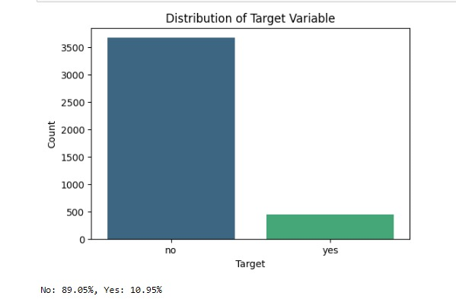

DATA CLEANING & PREPROCESSING
01
Handling Missing Values & Removing Duplicates
"unknown" and "nonexistent" data -> Imputing with most frequent value.
12 duplicated data.
02
Outlier Detection and Handling
Identified using the Z-score -> Removed
03
Encoding & Scaling
Label Encoder & Map to 0 or 1.
Numerical columns -> StandardScaler to standardize the range.
04
Handling Class Imbalance
SMOTE (Synthetic Minority Over-sampling Technique) to balance the dataset by generating synthetic examples for the minority class.

Slide 4

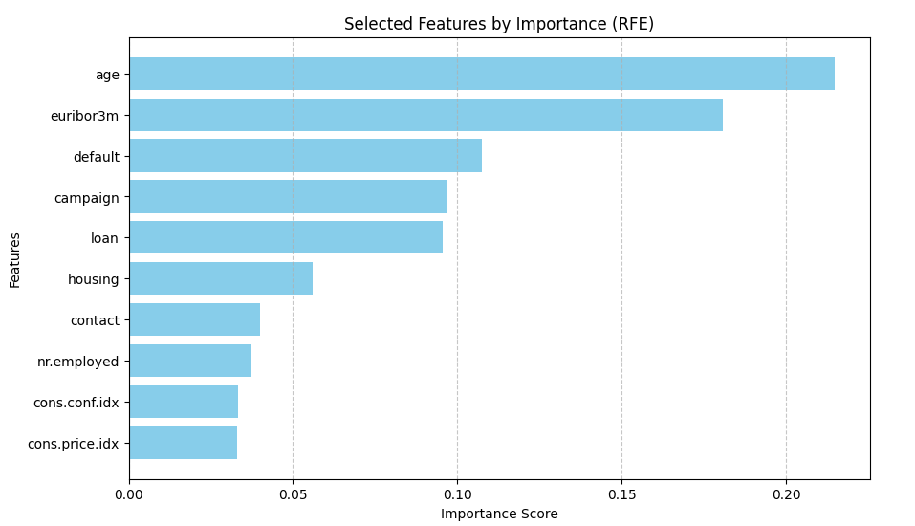

FEATURE SELECTION &
MODEL SELECTION
01
RANDOM FOREST
02
SUPPORT VECTOR CLASSIFIER
03
LOGISTIC REGRESSION
04
GRADIENT BOOSTING
05
VOTING CLASSIFIER
day_of_week
duration
poutcome
month

Slide 5
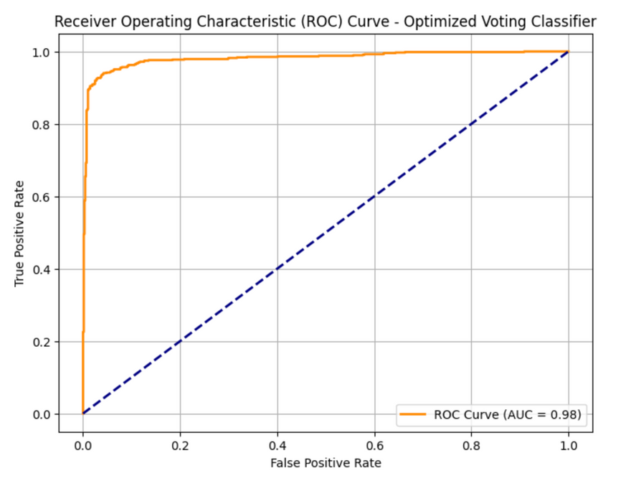
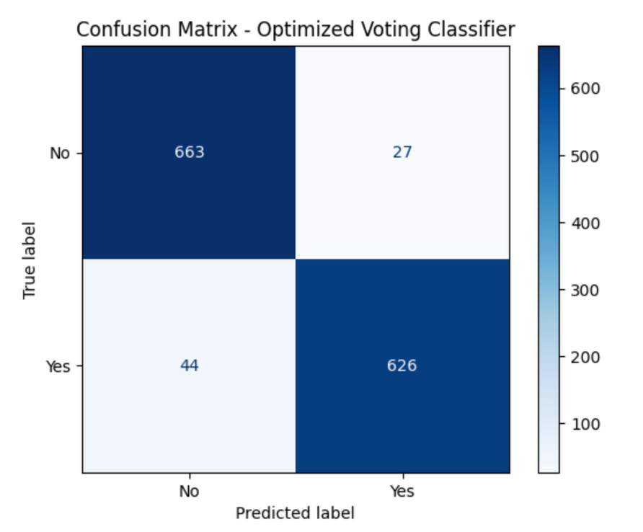
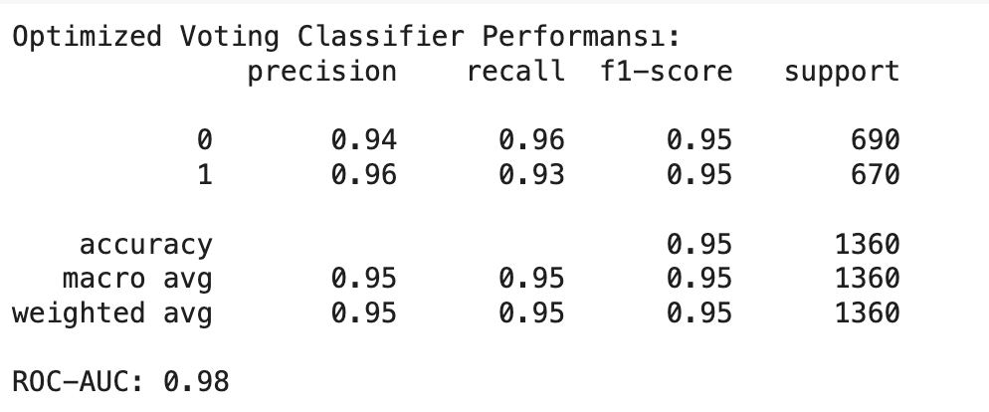
EVALUATION & DEPLOYMENT

Slide 6

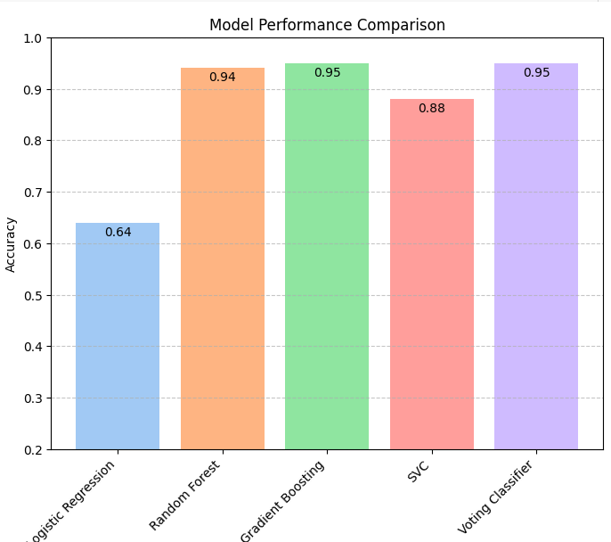
CONCLUSION
FINDINGS & RECOMMENDATIONS
Voting Classifier achieved the highest accuracy using key features like age, campaign, and euribor3m. Optimize campaigns for better results.
The selected features and optimized Voting Classifier can be used to focus marketing campaigns on high-potential customers, improving campaign success rates.
Machine learning models have provided significant insights into understanding customer subscription trends and developing targeted strategies for banking marketing campaigns.

